Slide 1
Data Science Careers: A primer for academics looking to switch to industry
Dr. J. Pocahontas Olson
Big Data Madison + Women in Big Data Meetups
April 28, 2020

Slide 2

My journey (to date)
Undergrad B.A. in Physics & Math, minor in CS
2 years at Epic Systems (interface team, EDI)
Decided to go to get my PhD in Physics
4 years in High Energy Phenomenology – published 2 papers
4ish years in Nuclear Astrophysics – worked on 4 papers, 2 published so far
Data Science bootcamp (1 week)
1 year as Data Scientist at Virtustream (cloud service provider, entirely remote)
3 years as Data Scientist at American Family Insurance
Consultant → Data Scientist I → II → III → Senior Data Scientist
Additional reading: academia to data science route very similar to mine: https://towardsdatascience.com/academia-to-data-science-91558063aa9e

Slide 3
An unflattering comparison
Academia
Industry
Limited opportunities, assumed a hinderance until proven otherwise
Supply/demand inequalities lead to 60+ hour weeks
Hazing culture: I worked myself into the ground and now I’m a professor
Chronically underfunded, pass lack of money onto student
Gaslighting: it’s a privilege to be treated like a second class citizen, or once you leave you’ll never be able to come back
Growth industries want to take on more projects than they have people to take them on
Work-life balance, flex time
Open market means a supportive and friendly culture is very important for retention
Multimillion dollar budgets include on labor costs
When salary maxed, provides work benefits and negotiates for career advancement

Slide 4
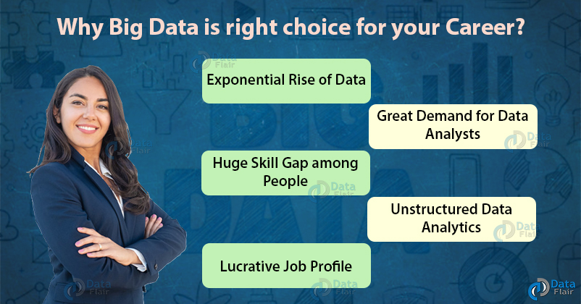
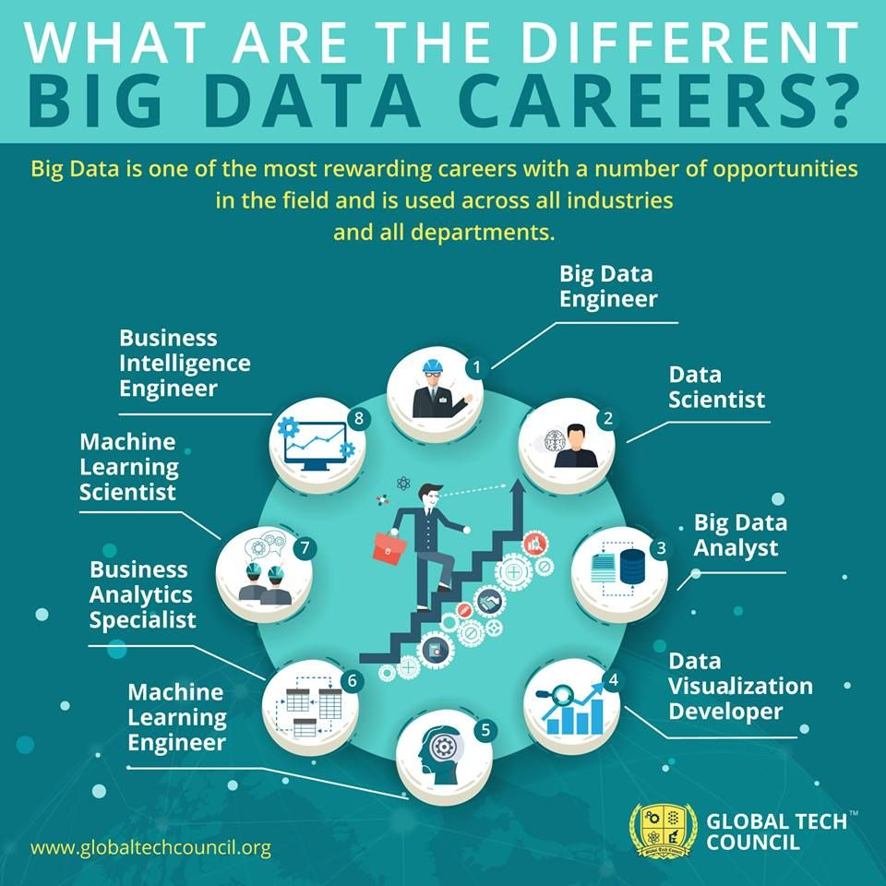
Careers in Big Data
HARVARD BUSINESS REVIEW calls data science “the sexiest job in the 21st century,” and by most accounts this hot new field promises to revolutionize industries from business to government, health care to academia. April 2013
^ https://data-flair.training/blogs/why-choose-career-in-big-data/ < https://www.globaltechcouncil.org/big-data-analytics/certified-bigdata-expert/

Slide 5
Careers in Big Data - abridged
Data Science
Data Analyst
Research
Data Engineer
Software Development

Slide 6
Career Prep
Peruse job postings in your area – this is what HR thinks you’d be doing
Peruse linked-in profiles of people in your area – this is who you’ll be talking with
Attend meetups where you can talk to people in person! ;-)
Embrace being a non-standard applicant
Might have to apply to more places until find a team that can use your skills

Slide 7
What to pick up while still in school
Git!! Any systematic way to collaborate
Random forest or XGBoost?
Leadership opportunity – host a conference?
Python preferably, but R works too
Recommended websites with great articles:
https://towardsdatascience.com/

Slide 8
Bootcamps, Fellowships and Online Classes
Bootcamps:
Data Science Dojo (1 week)
Science to Data Science (5 weeks)
Fellowships:
The Data Incubator Fellowship Program (8 weeks)
Insight Data Science Fellows (7 weeks)
Online classes:
Andrew Ng Coursera class (standard)

Slide 9
Considerations for your Job Search
Location / Remote work
Consulting
Get to see if you like it. If you don’t, doesn’t look bad on your resume to leave.
Internships not what you’d want them to be – we’re all expected to learn on the job, internships are for current data science students to do a small project with real world data
Glassdoor has company reviews in addition to job postings
Red flags:
Job description has a lot of
Report writing (they need a data analyst)
The salary range is too low with no higher positions (e.g. Data Scientist II)
You’re the only data scientist on the team (if you’re new to the field)

Slide 10
Typical interview process
Resume screening
Often done by HR, looking for keywords and experience / academic background
Code Assessment
Automated way to evaluate applicants
Technical screening (telephone)
First interaction with team members
Onsite / face-to-face interview (zoom)
Full- or half-day to meet entire team

Slide 11
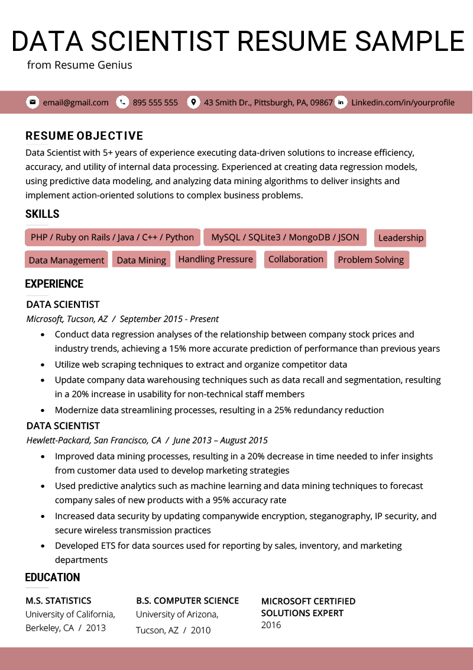
Resume tips
A large majority of applicants have:
2-year Masters in related field
Little industry/coding experience; except for 1-2 summer internships
Group project, using play datasets
Pros
Link to github
Names of models used (regression not bad)
1 page – resume is just foot in the door
Content matters – doesn’t need to be visually stunning (but still readable!)
https://resumegenius.com/resume-samples/data-scientist-resume-example >

Slide 12
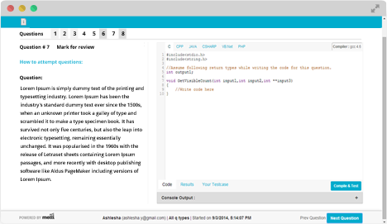
Preparing for Code Screening
Practice!
leetcode.com
Testing interfaces are different, don’t spend your time familiarizing yourself with the interface if you don’t have to

Slide 13
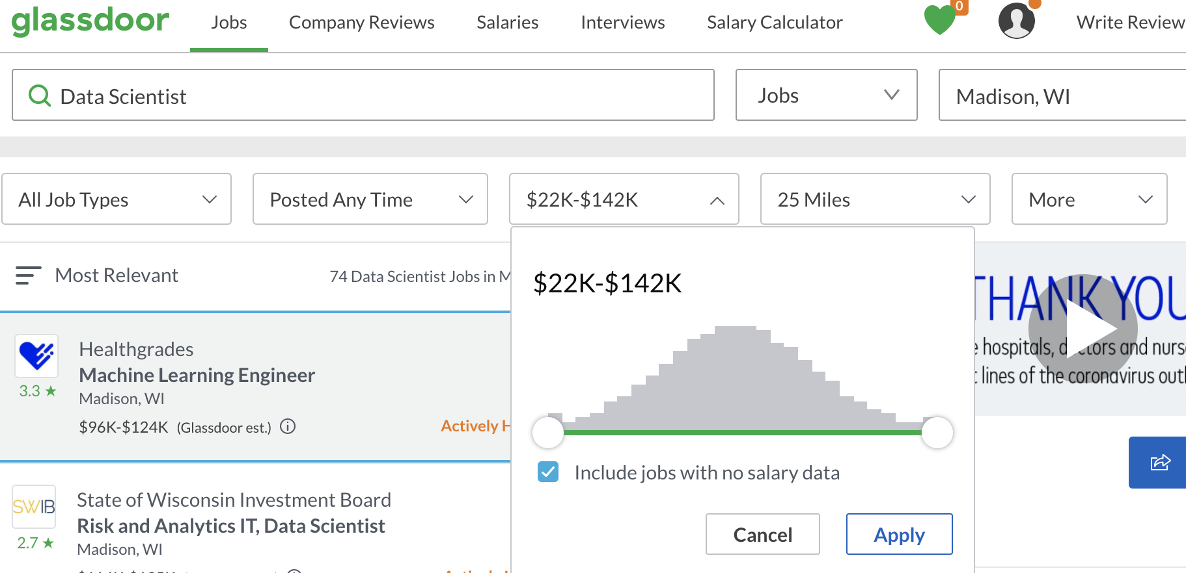
Negotiate for Salary
Glassdoor has salary information
Double your postdoc salary expectation
Ask for best case scenario – unlikely they’ll offer more than what you ask for
If you’re worried it’s too much, can ask if it’s reasonable early in process. Neither side wants to waste time.

Slide 14
Once you have your job
Value all coworkers, regardless of their route to the job
Give back! You can help others by
Sharing your experience
Ensure your hiring pipelines allow for skilled candidates, even with little demonstrated experience in the field
Answering emails about work in your career (we still do science!)
Offer to review resumes
Refer people who approached you to anyone you know is hiring
Remind job seekers there are many routes to success
Keep learning! Attend conferences (virtual now?), courses, meetups, etc.

